Slide 1
ALBERT
A LITE BERT FOR SELF-SUPERVISED LEARNING OF LANGUAGE REPRESENTATIONS (2019)
Kilian, Yernar, Alex, Misha

Slide 2
What insights have we gained from this course up to this point? [3]
Types of representations:
context-free
context-based (unidirectional or bidirectional)
word2vec is an example of context-free representation.
What are some examples for context-free and context-based ones?

Slide 3
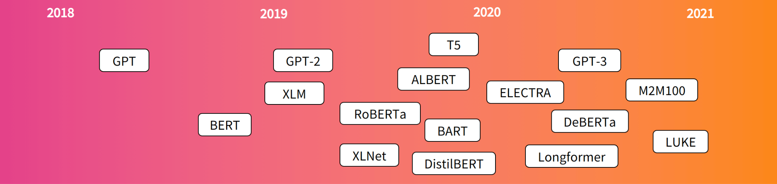
Timeline of some transformers [2]

Slide 4
What is BERT? [4]
Bidirectional Encoder Representations from Transformers
It is bidirectionally trained, i.e., considering previous and next tokens at the same time
It uses transformer model architecture, but only the encoder part.
It is not trying to predict the next word in a sentence.
Instead, it uses Masked LM (MLM) and Next Sentence Prediction (NSP)
MLM: understanding the relationship between words
NSP: understanding the relationship between 2 sentences

Slide 5
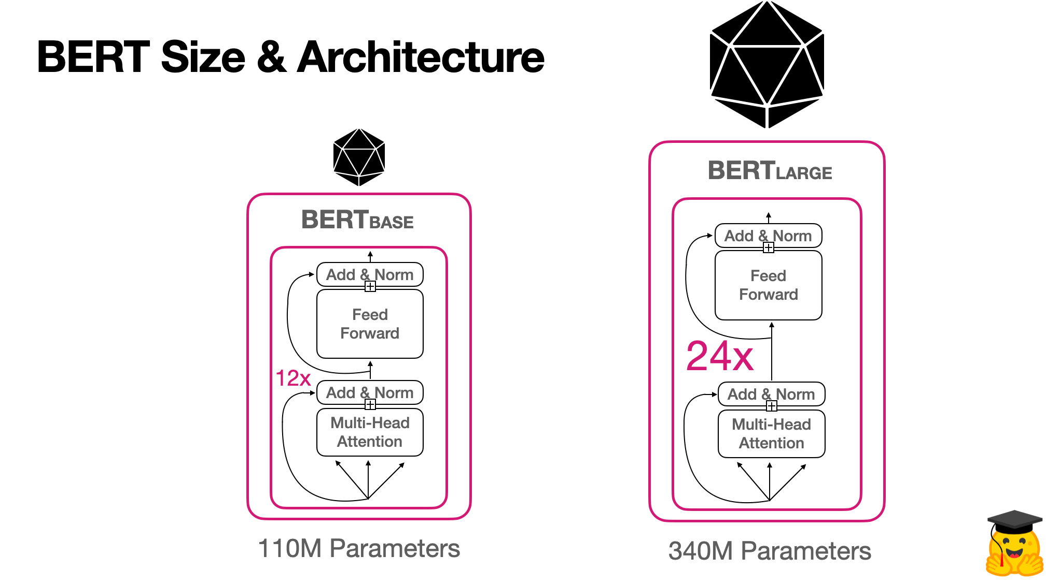
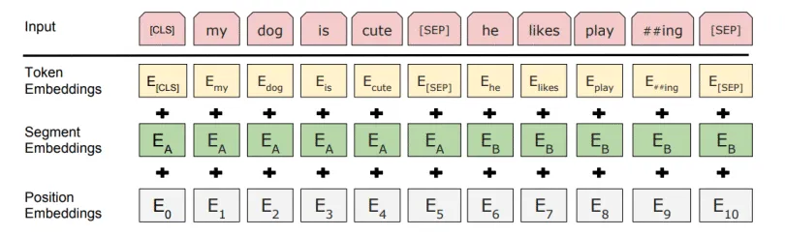
BERT Architecture [2] & Embedding Step [3]

Slide 6
What is the main drawback of BERT? [5]
It requires a lot of GPU resources to be trained, because of the many parameters (110 million or 340 million) [4]
Much more parameters when compared to a CovNet (ca. 100 000 parameters)
Solution:
Try to achieve similar performance of the model, but with less parameters.
or rephrased:
Is having better NLP models as easy as having larger models? [1]

Slide 7
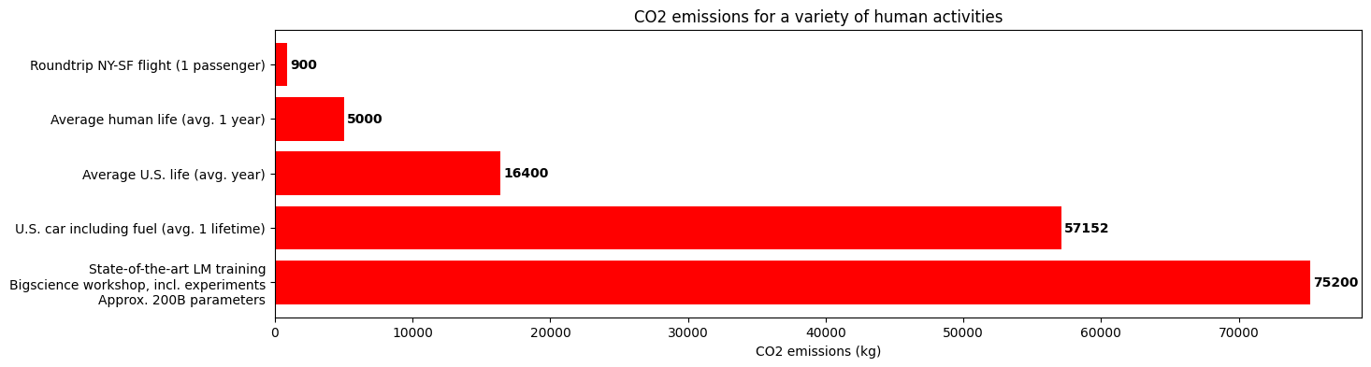
Environmental friendliness of language models [2]

Slide 8
Cross-Layer Parameter Sharing in ALBERT
Parameter sharing is a common approach by decoder-encoder tasks and pretraining/finetuning setting.
There are three standard parameter sharing procedures in transformers:
sharing of feed-forward network;
sharing of attention parameters;
sharing of both FFN and attention parameters.
ALBERT utilises the third approach.
Increased efficiency and decreased redundancy as outcome.

Slide 9
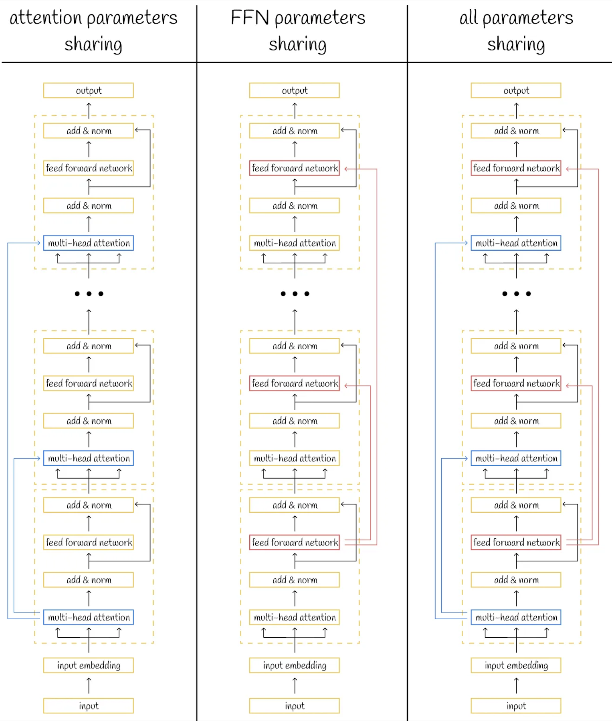
Cross-Layer Parameter Sharing in ALBERT

Slide 10
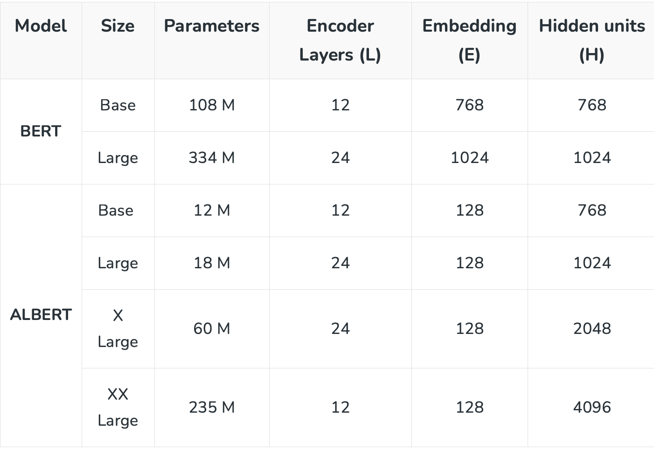
Cross-Layer Parameter Sharing in ALBERT
Using of parameter sharing approach reduces general amount of model parameters drastically.

Slide 11
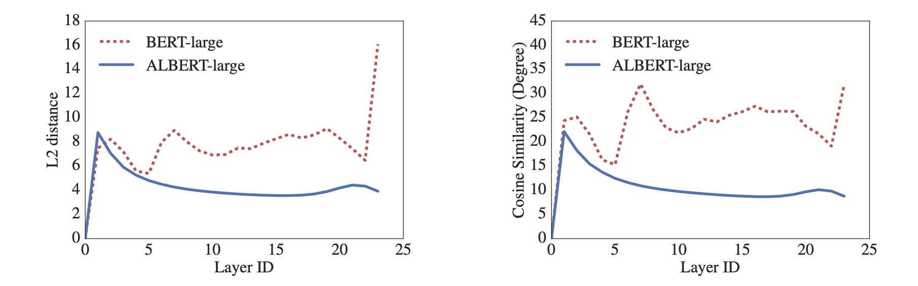
Cross-Layer Parameter Sharing in ALBERT
Cross-layer parameter sharing has a certain influence on embedding transitions between input and output layers.
ALBERT transitions are quite smooth while BERT’s ones are fluctuating → ALBERT’s network parameters are stabilised.

Slide 12
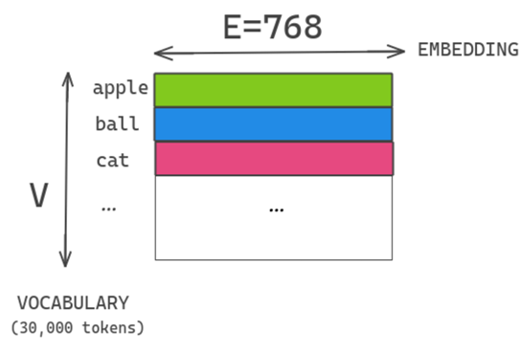
Factorized embedding parametrization
WordPiece Embedding E tied to H → E = H
V = Vocabulary Size
E = Embedding Size
H = Hidden layer Size

Slide 13
Factorized embedding parametrization
NLP requires large Vocabulary size (V).
If E = H → H increases size of embedding matrix (E), which is VxE.
As result a model with billions parameters is obtained (a majority of these parameters is only updated sparsely during training).

Slide 14
Factorized embedding parametrization
WordPiece Embedding (E) are meant to learn context-independent representation.
Hidden Layer (H) Embeddings are meant to learn context-dependent representation.
Untying E from H allows more efficient usage of model’s parameters → H >> E

Slide 15
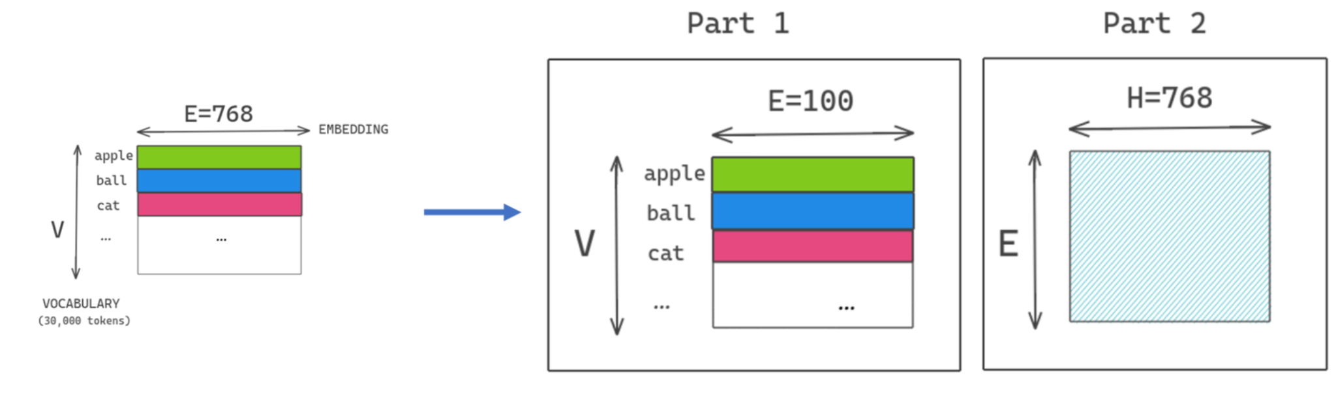
Factorized embedding parametrization
O(V x H)
30k x 768 = approx. 23M
O(V x E + E x H)
30k x 100 + 100 x 768 = approx. 3M

Slide 16
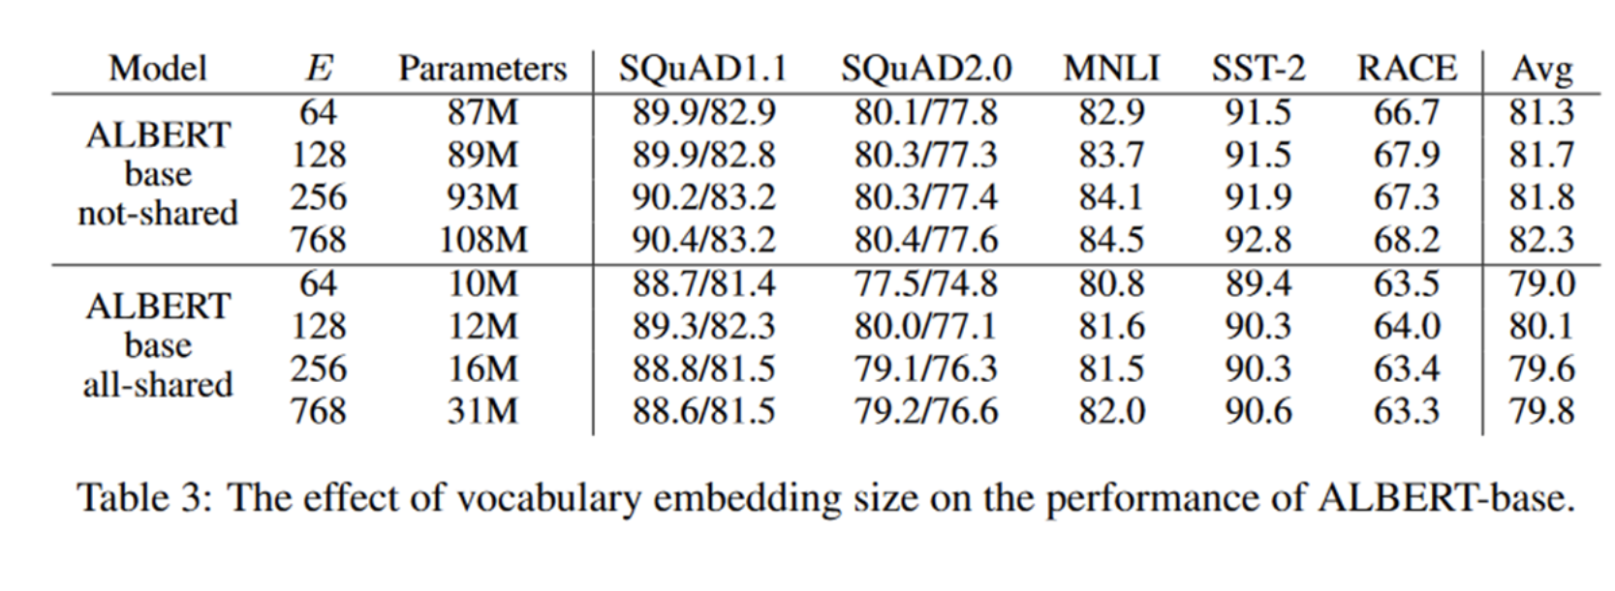
Factorized embedding parametrization

Slide 17
Understanding SOP in ALBERT
Self-supervised loss, Sentence Order Prediction.
Focuses on improving the understanding of sentence coherence.
Uses two consecutive segments from the same text as (+) example.
Reversed order of same two consecutives as (-) example.
forces the model to learn finer distinctions about discourse-level coherence properties.

Slide 18
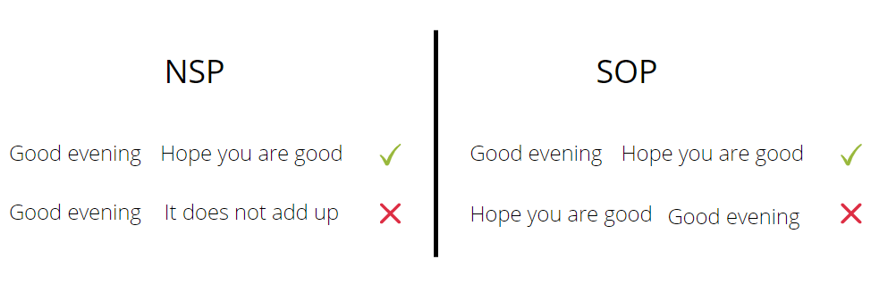
NSP is a binary classification loss:
(+) topic prediction
(-) coherence prediction
SOP based primarily on coherence:
(+) learns finer-grained distinctions
(+) improves downstream task performance
BERT transformers summary - ALBERT, RoBERTa, Longformer, ELECTRA, ... — The NLP Space

Slide 19
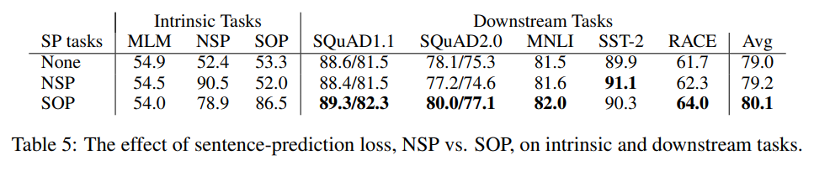
Experiment and Result
Additional inter-sentence loss experiment using an ALBERT base configuration.

Slide 20


References
[1] Z. Lan, M. Chen, S. Goodman, K. Gimpel, P. Sharma, and R. Soricut, “ALBERT: A Lite BERT for Self-supervised Learning of Language Representations.” arXiv, Feb. 08, 2020. Accessed: Dec. 22, 2023. [Online]. Available: http://arxiv.org/abs/1909.11942
[2] B. Muller, “BERT 101 State Of The Art NLP Model Explained.” [Online]. Available: https://huggingface.co/blog/bert-101
[3] S. Khalid, “BERT Explained: A Complete Guide with Theory and Tutorial — samia.khalid.” [Online]. Available: https://medium.com/@samia.khalid/bert-explained-a-complete-guide-with-theory-and-tutorial-3ac9ebc8fa7c
[4] J. Devlin, M.-W. Chang, K. Lee, and K. Toutanova, “BERT: Pre-training of Deep Bidirectional Transformers for Language Understanding.” arXiv, May 24, 2019. Accessed: Dec. 22, 2023. [Online]. Available: http://arxiv.org/abs/1810.04805
[5] C. Versloot, “machine-learning-articles/albert-explained-a-lite-bert.md at main · christianversloot/machine-learning-articles — github.com.” [Online]. Available: https://github.com/christianversloot/machine-learning-articles/blob/main/albert-explained-a-lite-bert.md

